Slide 1

TOPICS
SOIL CONVERSATION
WATER CONSERVATION
ENERGY CONVERSATION
ROLL NUMBERS:
208W1A1296
208W1A1297
208W1A1298
208W1A1299
208W1A12A0

Slide 2
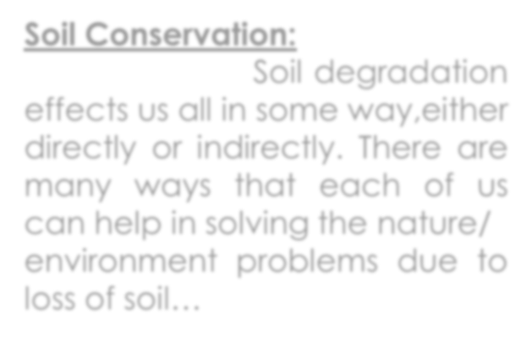


Soil Conservation:
Soil degradation effects us all in some way,either
directly or indirectly. There are many ways that each of us can help in solving the nature/
environment problems due to loss of soil…

Slide 3
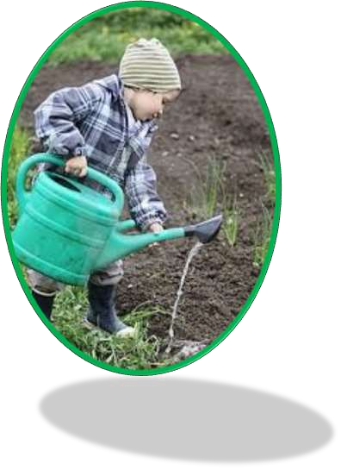
DO’S:
Cover the soil in your farm or garden with a layer of mulch to prevent soil erosion in the rains and to conserve soil moisture. Mulch can be made from grass clippings or leaf litter.
If you plan to plant on a steep slope in your farm or garden, prevent soil erosion by first terracing the area. Terraces help in slowing the rain water running downhill so it can soak into the soil rather than carry the soil away.
Help prevent soil erosion in your community by planting trees and ground-covering plants that help hold the soil in place. You might organize a group of citizens to identify places that need planting, raise funds, work with the local government to plant trees, shrubs and grasses, and maintain them over the long term.
In your vegetable garden, rotate crops to prevent the depletion of nutrients. Legumes such as peas and beans put nitrogen back into the soil.

Slide 4



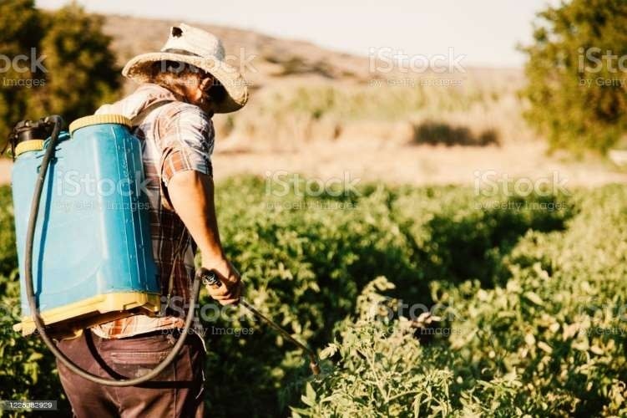
DONT’S:
Do not remove grass, leave it on the lawn. Cuttings serve as moisture- retention mulch and a natural fertilizer.
Do not use toxic pesticides in your garden— they often kill the beneficial organisms, your soil needs to stay healthy.
Don’t strip or remove topsoil for sale, as this is an offence unless you have planning permission.
Don’t apply inorganic fertilisers or organic manures without taking account of soil nutrient status and crop requirements.

Slide 5
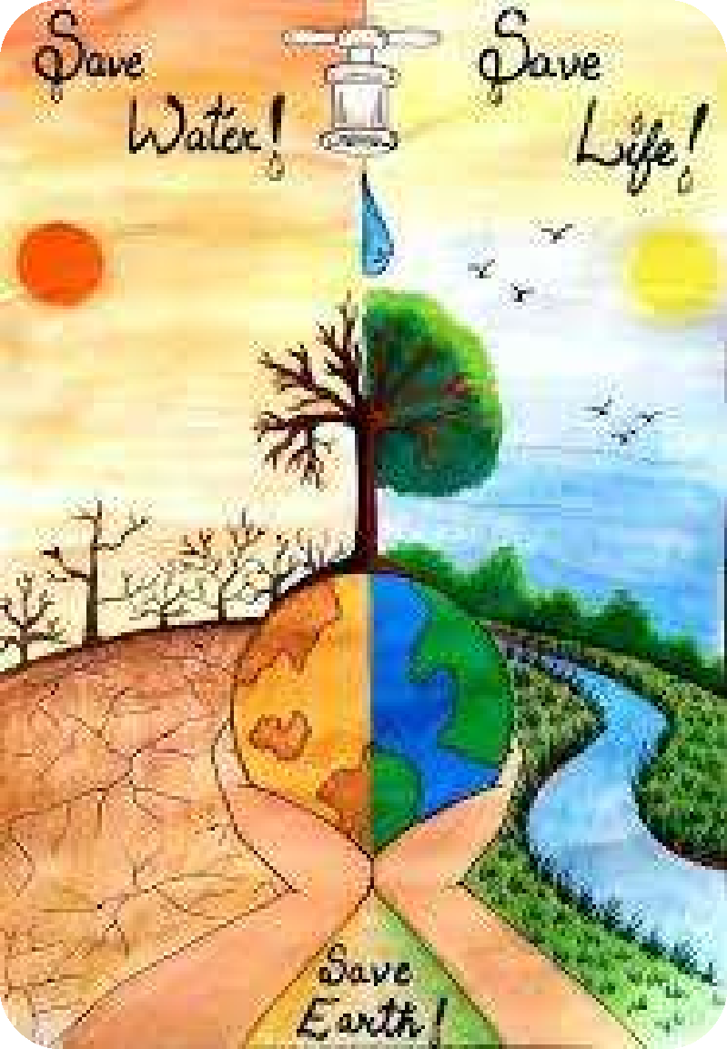

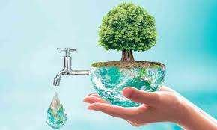

Water Conservation:
Most of India has good average annual rainfall, however we still face a water shortage nearly everywhere. This is one of the major environmental problems in our country.
Conservation of this very precious natural resource is very important and it is the need of the hour.
It should start with every individual. It must start with you! Following are some of the things you can do to conserve this precious natural resource…

Slide 6
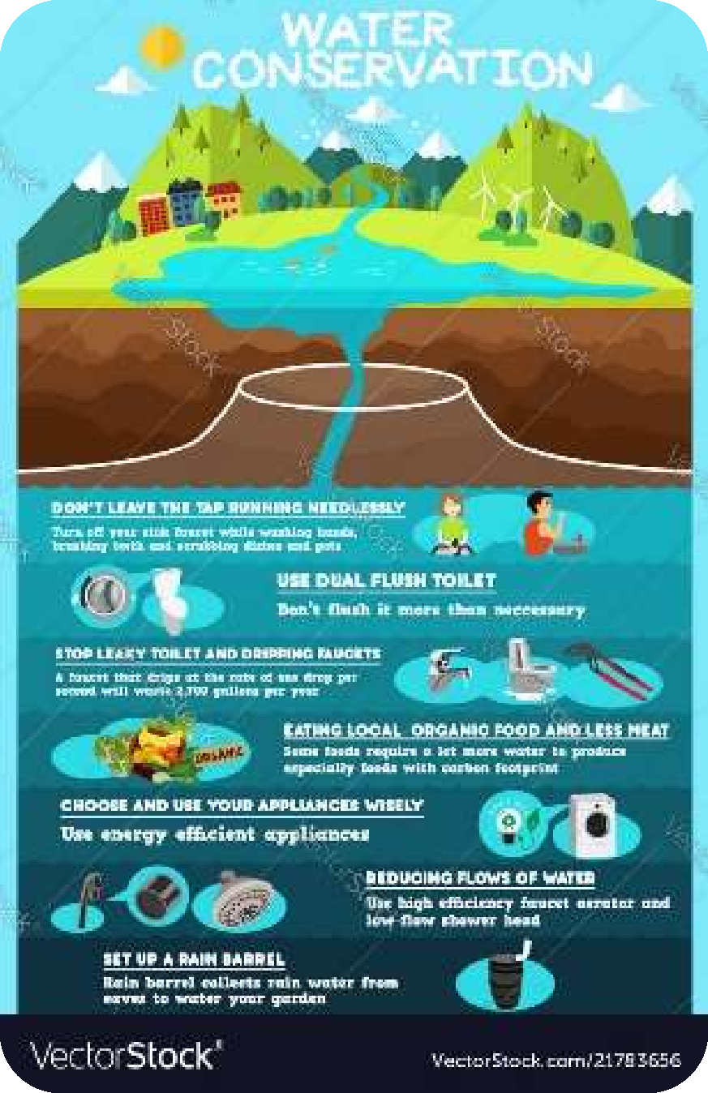
DO’S:
Reduce the amount of water used for daily activities. For example - turn off the tap while brushing your teeth to save water.
Reuse the rinsing water for house-plants. Reuse the water that vegetables are washed in to water the plants in your garden or your potted plants.
Always water the plants early in the morning to minimize evaporation.
Soak the dishes before washing them to reduce
water and detergent usage.
Saving precious rainwater is very important. Harvest rainwater from rooftops and use it sustainably to recharge wells to reduce the burden on rivers and lakes.
Use a drip irrigation system to water more
efficiently

Slide 7

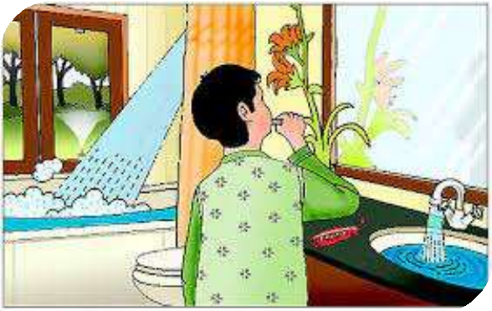
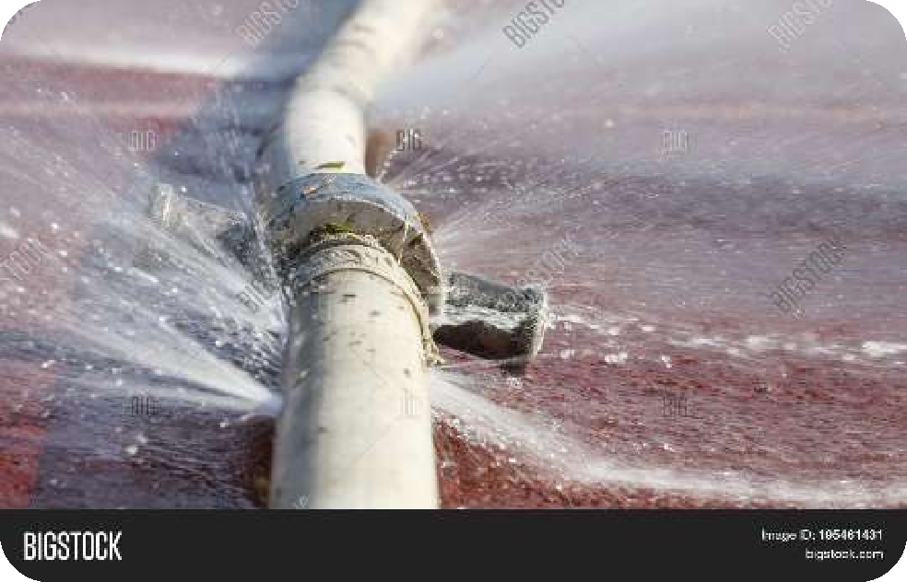
DON’T’S:
Do not turn your tap on full force, instead
maintain a slow flow.
Do not use a shower, instead use a bucket of water for bathing. A 10 minute shower wastes many liters of water as compared to using water from a bucket.
Do not over water garden plants, water them
only when necessary.
Do not pollute sources of water or water bodies by throwing waste into them. This is the water you or someone else has to drink!
Do not throw waste into toilets because finally
it goes into water bodies.
DON’T let the water run while washing dishes.

